Slide 1
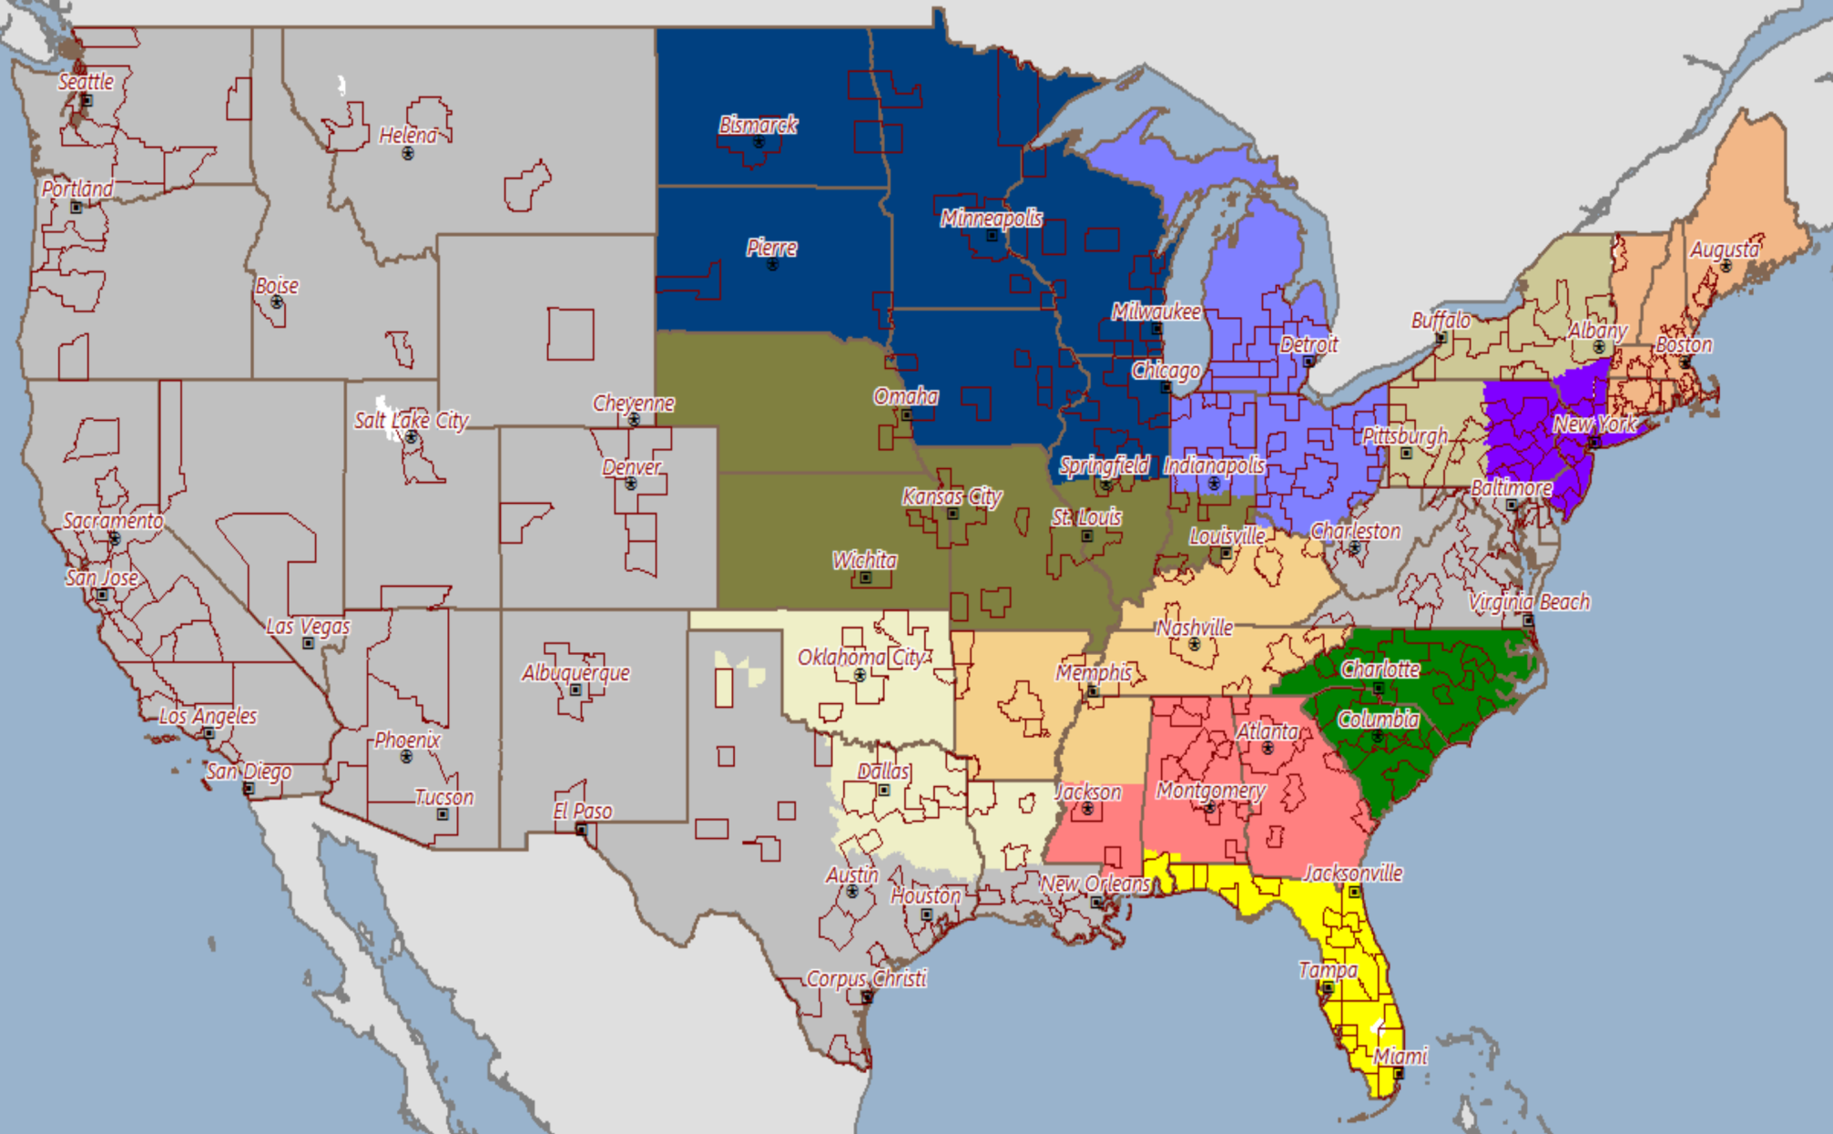

National Distribution Network
TBD
TBD
TBD
TBD
David Mack
Sustainable Medical
Stacey Roberts
Doug Stairs
Arete Group
TBD
TBD
Mark Gronowski
Paul Kase
Neil House
TBD
Sustainable Medical
Sustainable Medical
TBD
Phil Sherriffs/Dr. Jason Chiriano
Tim Blanc
Mike McClaflin
Matt DiDuro
Brian Lee
Shannon Drost
TBD
Bob Cox
Robert/Liz
Donna Alexander
Laurie Gibbons
Terri Hillman

